Slide 1
Xəlilov Eltun-2450i
Operating system
Apple M1 CPU

Slide 2
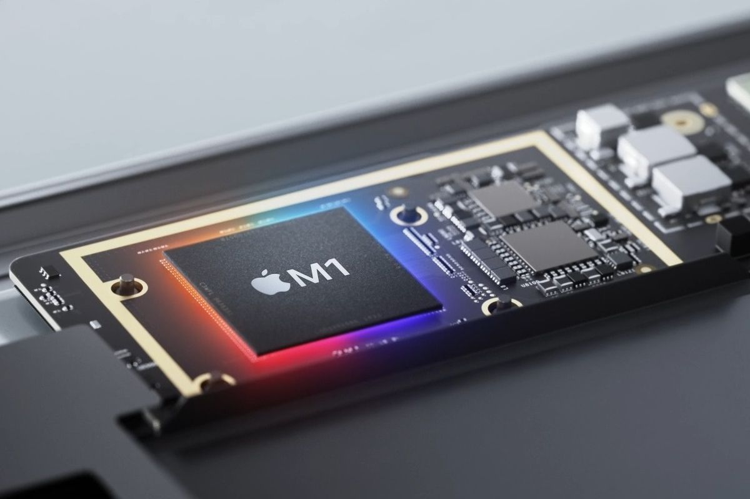
What Is the Apple M1?
A processor that Apple developed in-house powers the newest Macs and iPad Pro. It's a mighty powerful chip, but it's not without a few quirks.

Slide 3
Apple’s newest Macs don’t come with Intel processors. Instead, they use the brand-new Apple M1 chip, a powerful replacement for the many generations of Intel CPUs that have powered Apple computers since 2006.The M1 is the first appearance of the new paradigm that Apple has dubbed Apple Silicon. The new Macs available with the M1 include the MacBook Air, the 13-inch MacBook Pro, the Mac mini, and the new 24-inch iMac. The newest iPad Pro also uses the M1.Apple’s M1 offers tantalizing improvements to computing performance, graphics output, and battery life. The M1-based MacBook Air demonstrates performance equal to or better than its predecessors and many Windows competitors. This is even true for some apps that run natively on older Intel-powered machines but use Rosetta 2 emulation on the MacBook Air.

Slide 4
The M1: An Entire System on a Chip
Whether they run Windows, macOS, or Chrome, most of today’s PCs come with an array of computing components inside that each handle different processing tasks. These include one processor (the CPU) for handling essential computations, including those used for browsing the internet and opening and closing apps, and another (the GPU) for processing graphics computations and outputting a signal to your monitor or laptop screen. PCMag Logo Apple's 4/20 event gave us AirTags, an M1 iPad Pro, and a brand new iMac On large, powerful machines like workstation desktops and gaming rigs, the CPU and GPU are completely separate items that are each connected to the motherboard. Smaller ultraportable laptops typically combine the CPU and GPU into a single component using what’s known in the industry as integrated graphics processing, with the rest of the computer’s components, including cache, memory, and storage, located in different spots on the motherboard. As an evolution of the Apple A-series processors that have long powered the iPhone and the iPad, the M1 chip takes a different approach. Instead of a collection of separate processing parts, it’s a single system on a chip (SoC). The SoC handles all of the computations, including graphics output, which means that each software instruction can use the most efficient part of the M1.

Slide 5
Apple M1 chip diagram:
In part because it must do everything at once, the M1 has an eyebrow-raising maximum of 16 processor cores. That sounds like a ton compared with the six cores that are in the most powerful Intel laptop CPUs. In fact, the M1 has so many cores not so it can perform tasks more quickly, but so it can perform more tasks. Four of the cores are compute cores dedicated to complex calculations that require lots of processing power. Four more are dedicated to lighter tasks that don’t require as much power, to ensure that the chip doesn't consume more energy than it needs to. Tasks get shunted to the appropriate core set on the fly.

Slide 6
Thank you

